Slide 1
Lesson objective
Title: Volume fluency
Aim – be able to:
Substitute into formula to calculate volume of cuboids.
Plan:
Face refresh
Using formula
Calculating volume
Need whiteboards and calculators.

Slide 2
Fill in the blanks
Volume is the amount of space contained or taken up by a 3-_________ object. Volume can be determined by calculating the area of the _____________ (or face) and ___________ it by the ______ of the prism.
Write a description in your own words!
Multiplying cross-section Dimensional length

Slide 3
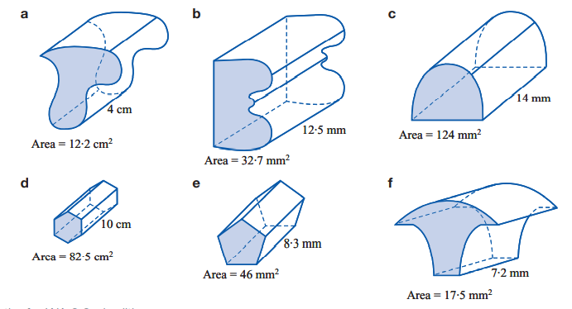
Volume practice

Slide 4
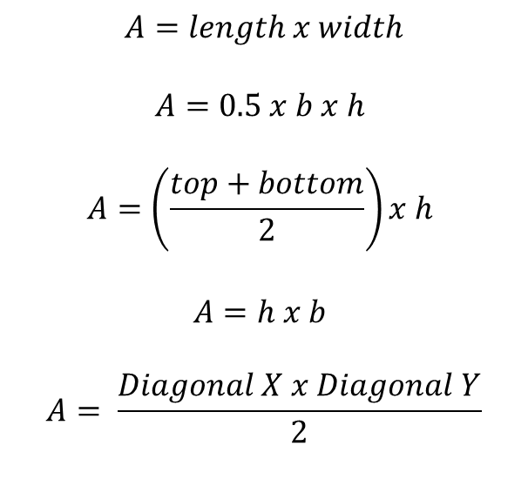
Problem solving
Match the AREA formula to the shape.
$$A=length x width$$
$$A=0.5 x b x h$$
$$A=\left(\frac{top+bottom}{2}\right)x h$$
$$A=h x b$$
$$A= \frac{Diagonal X x Diagonal Y}{2}$$

Slide 5
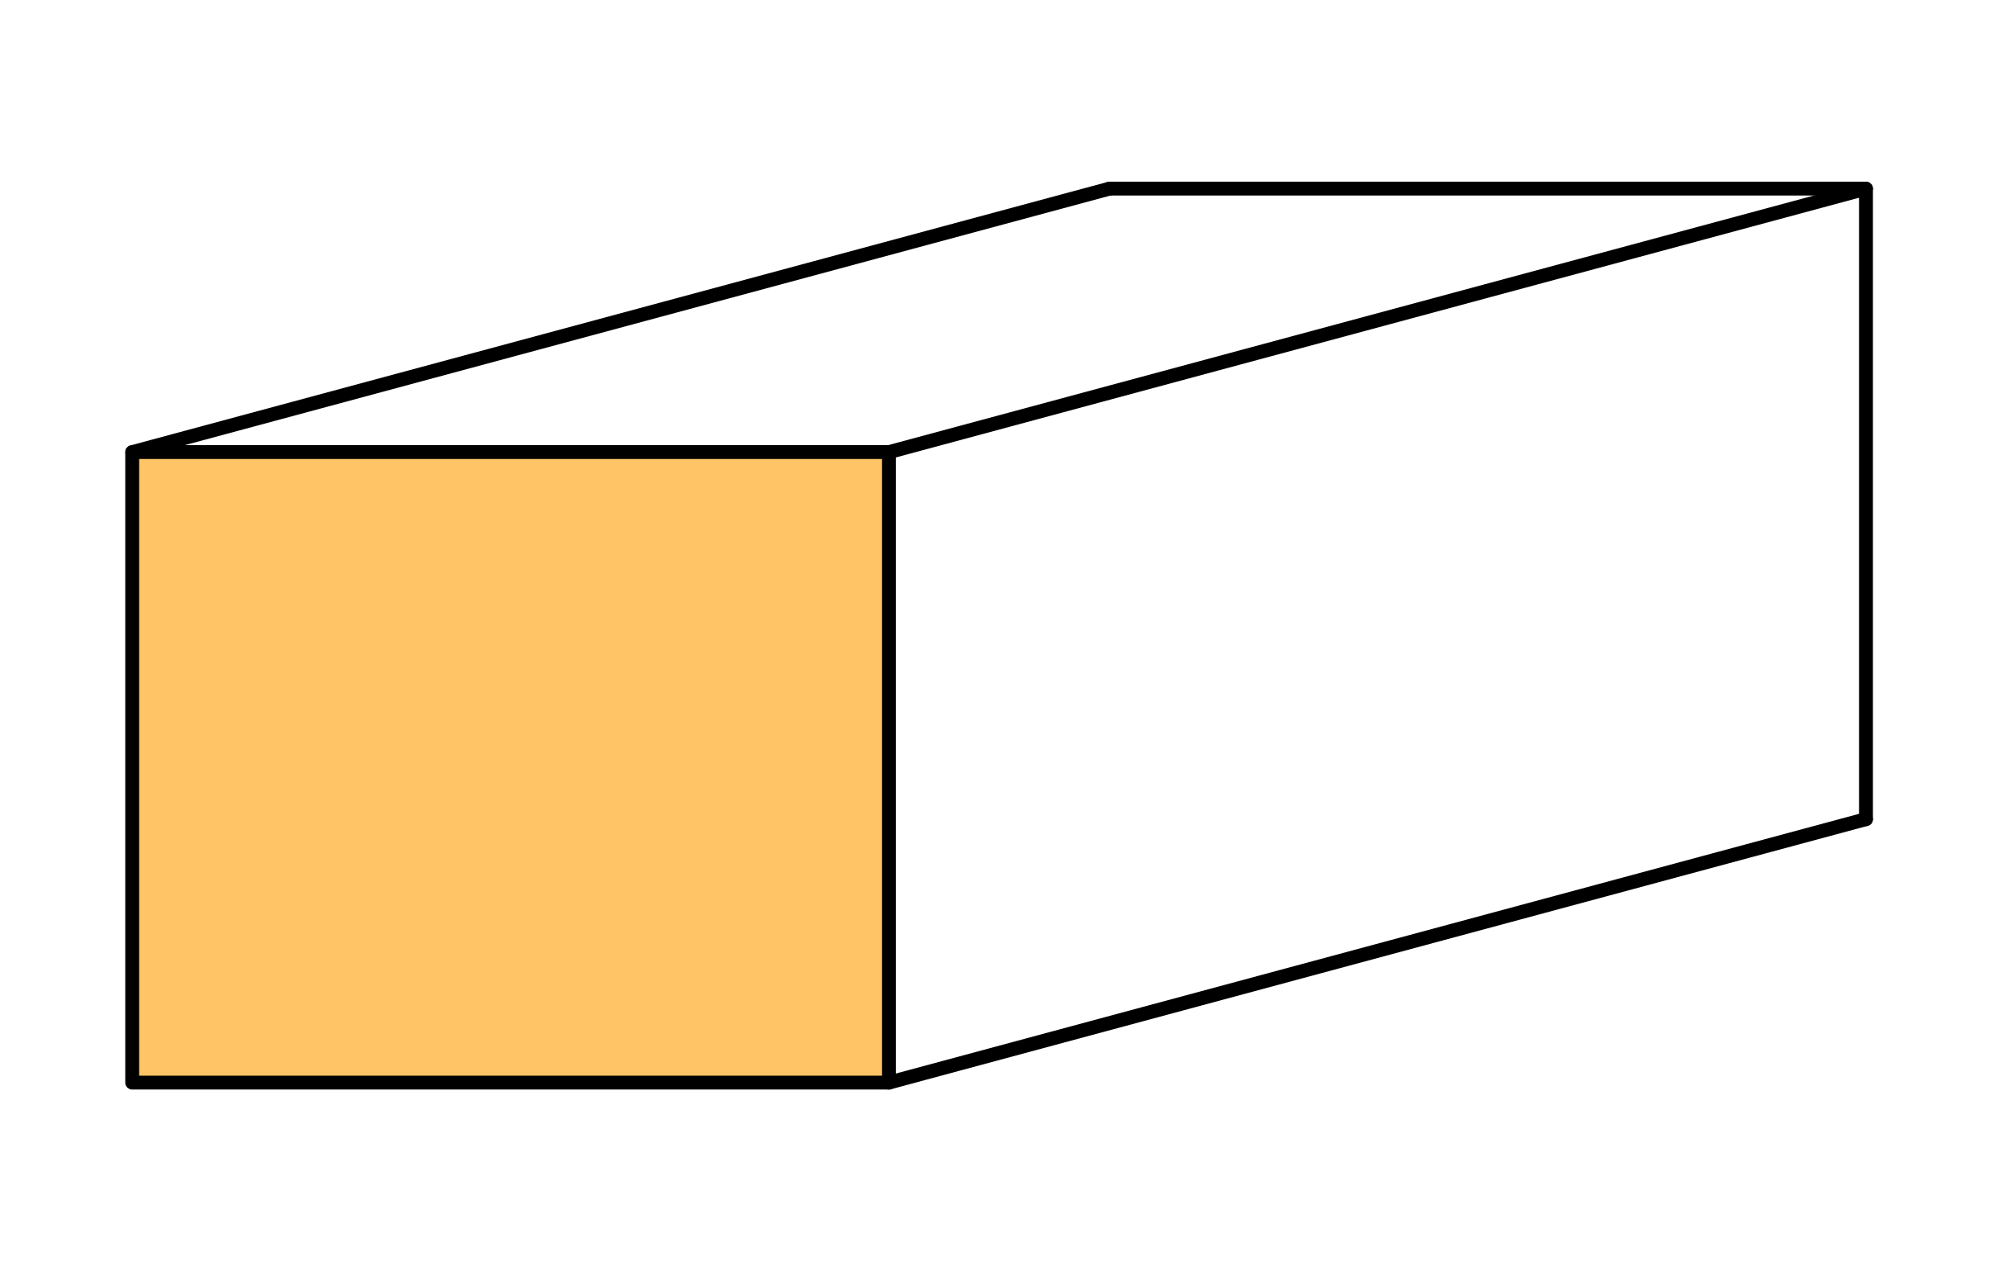
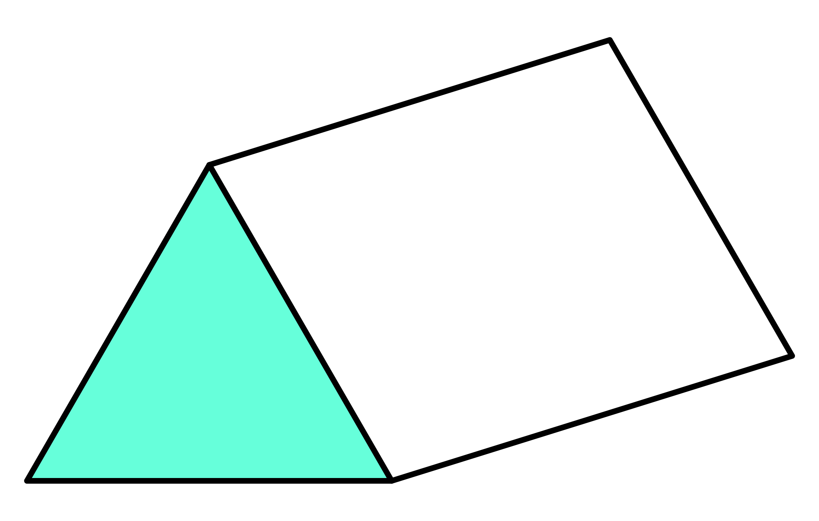
Substituting into formula: VOLUME
Diagram
Rule
Numbers
Solve
I do
We do
D:
R:
N:
S:
4m
6cm
8m
5m
8cm
7cm

Slide 6
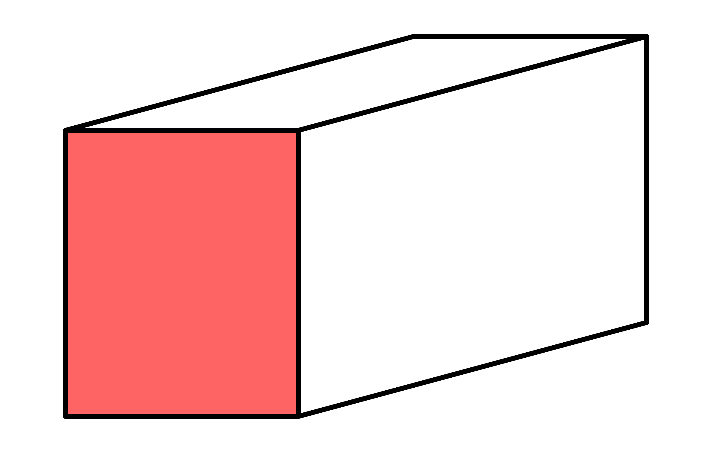
Whiteboards
Diagram
Rule:
Numbers:
Solve:
8cm
11cm
6cm

Slide 7
Whiteboards
Diagram
Rule:
Numbers:
Solve:
3m
20m
^{4m}

Slide 8
Whiteboards
Diagram
Rule:
Numbers:
Solve:
10mm
30mm
16mm

Slide 9
Whiteboards
Diagram
Rule:
Numbers:
Solve:
8m
10m
5.2m

Slide 10
Whiteboards
Diagram
Rule:
Numbers:
Solve:
1.6m
300cm
100cm

Slide 11
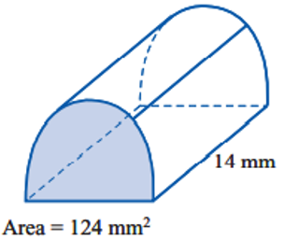
Whiteboards
Diagram
Rule:
Numbers:
Solve:

Slide 12

Whiteboards
16mm
16mm
16mm

Slide 13
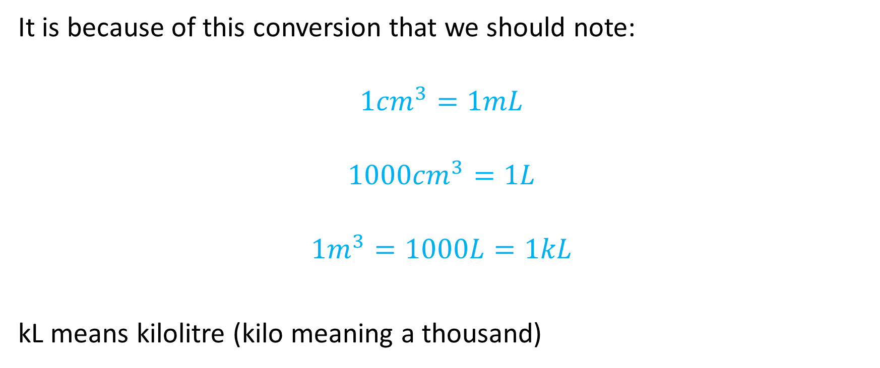
Worthy of note(s)
It is because of this conversion that we should note:
$${1cm}^{3}=1mL$$
$${1000cm}^{3}=1L$$
$${1m}^{3}=1000L=1kL$$
kL means kilolitre (kilo meaning a thousand)

Slide 14
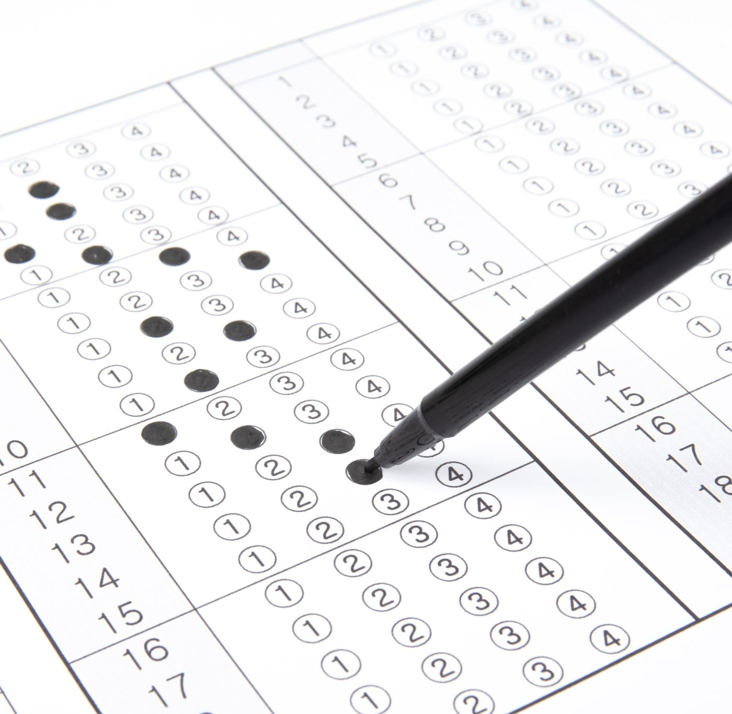
Individual practice
Area and volume Excel mathematics
Unit 13

